Slide 1
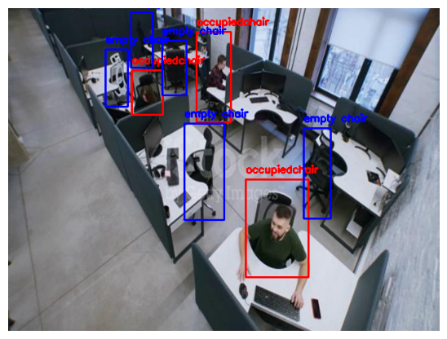
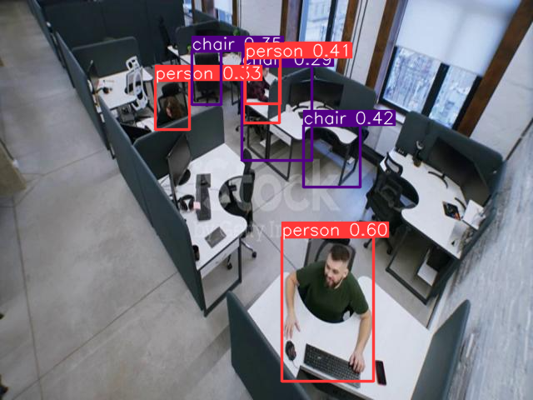
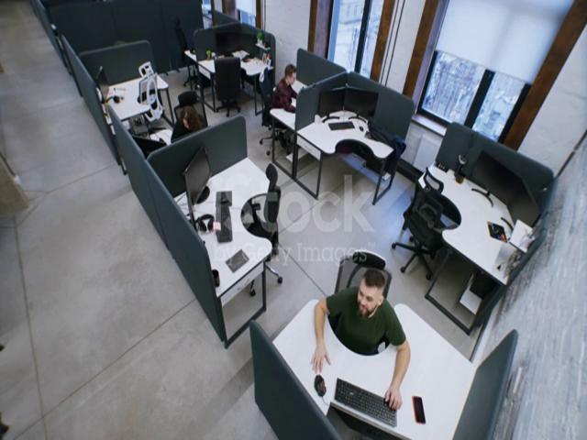
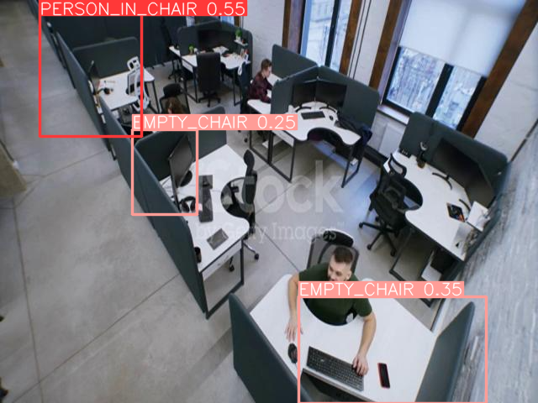
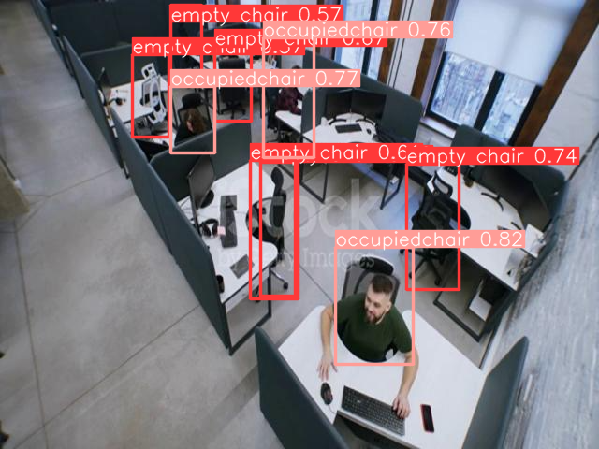
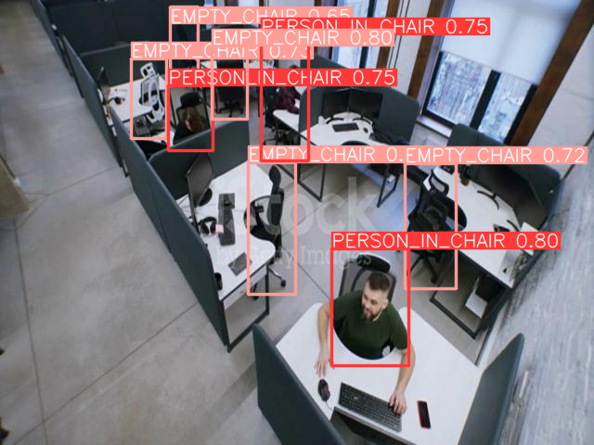
a) Ground Truth
b) Baseline: YOLOv8
c) Hand Curated, 100 epochs
d) Hand Curated, 50 epochs
e) Open-sourced, 100 epochs
f) Combined, 100 epochs

